Slide 1
Supervised Classification Decision Tree and RandomForest

Slide 2
Course Agenda
1
Introduction
2
Classification : Recap
3
Decision Trees
Decision Tree Classifier
Decision Tree Regression
4
Entropy
5
Information Gain
6
Ensemble Methods
7
Random Forests
8
End : Part 1
Notes:
Key Message(s):
Review the Agenda.
Additional Information:
This is just a brief reminder of where you are in the course. It will also help participants to know what is coming up.

Slide 3
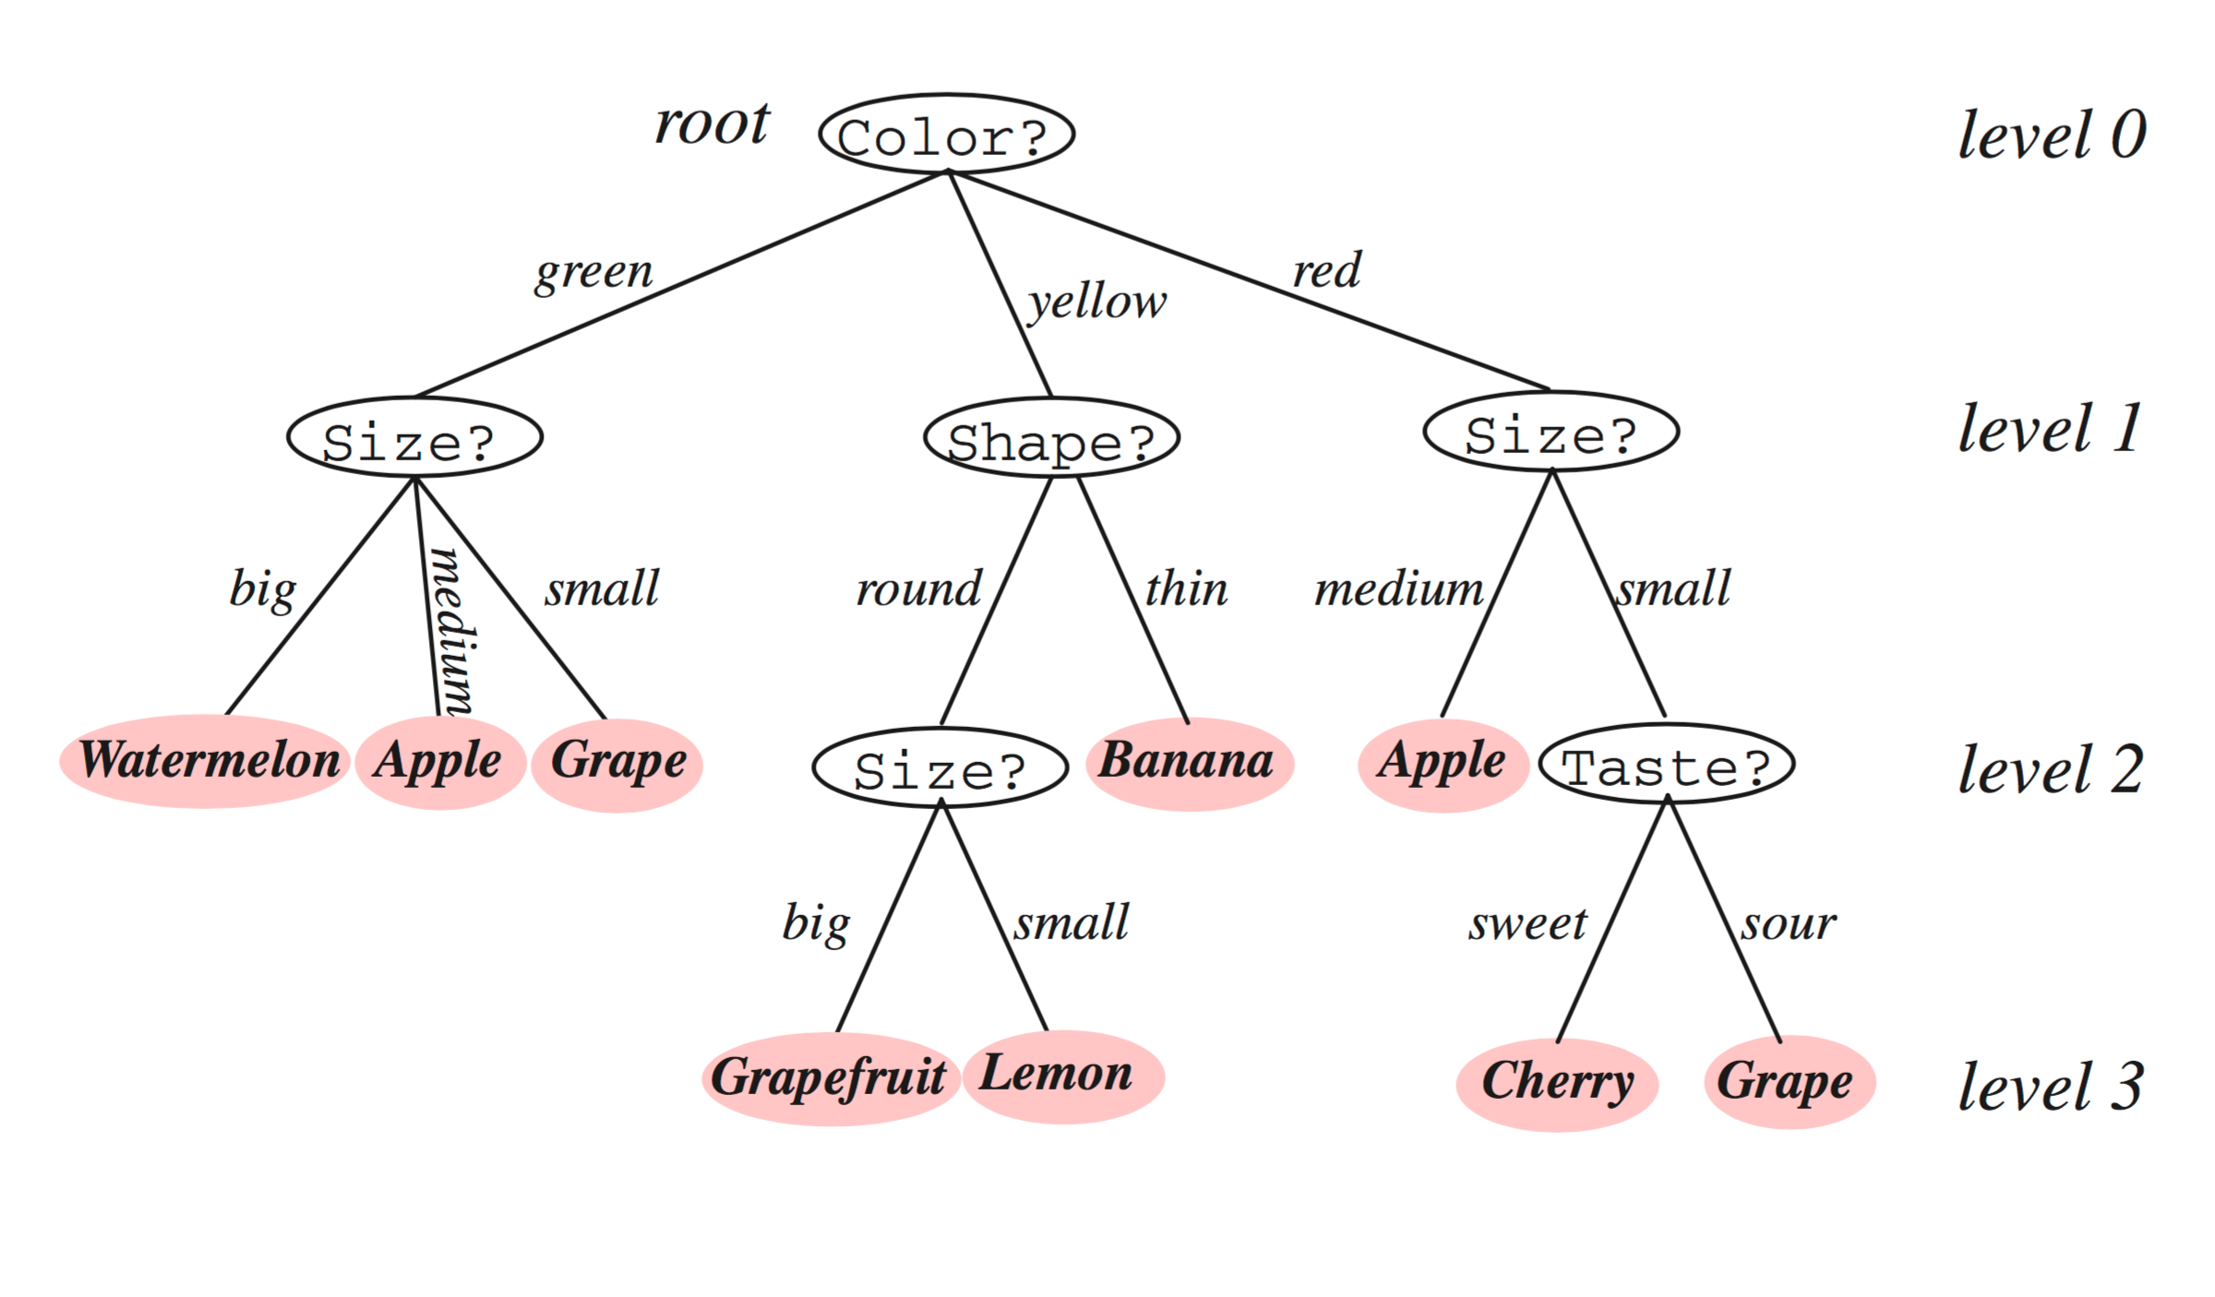
Intuition Behind Decision Trees

Slide 4
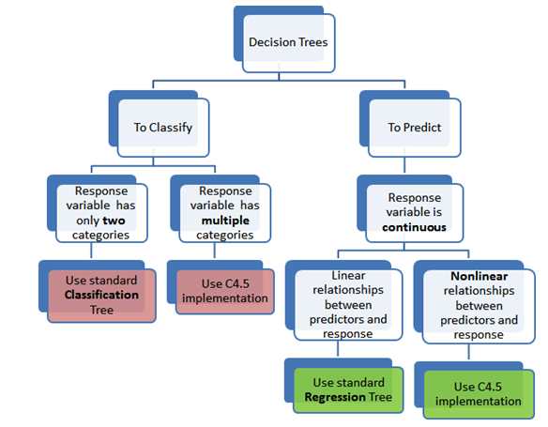
Types Of Decision Trees

Slide 5
ENTROPY
https://engineering.purdue.edu/kak/Tutorials/DecisionTreeClassifiers.pdf
http://www.ke.tu-darmstadt.de/lehre/archiv/ws0809/mldm/dt.pdf

Slide 6
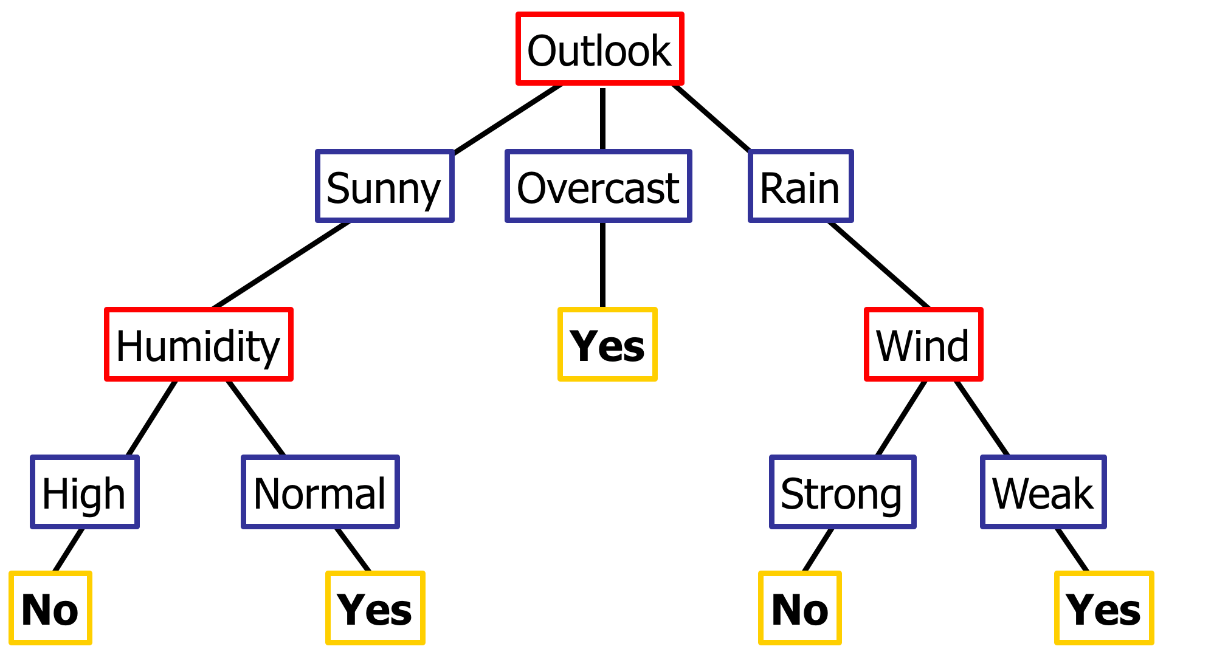
Decision Tree example : Playing Tennis ?

Slide 7
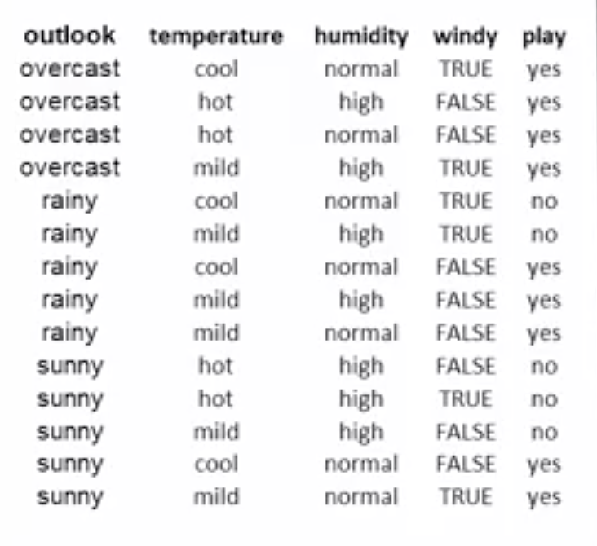
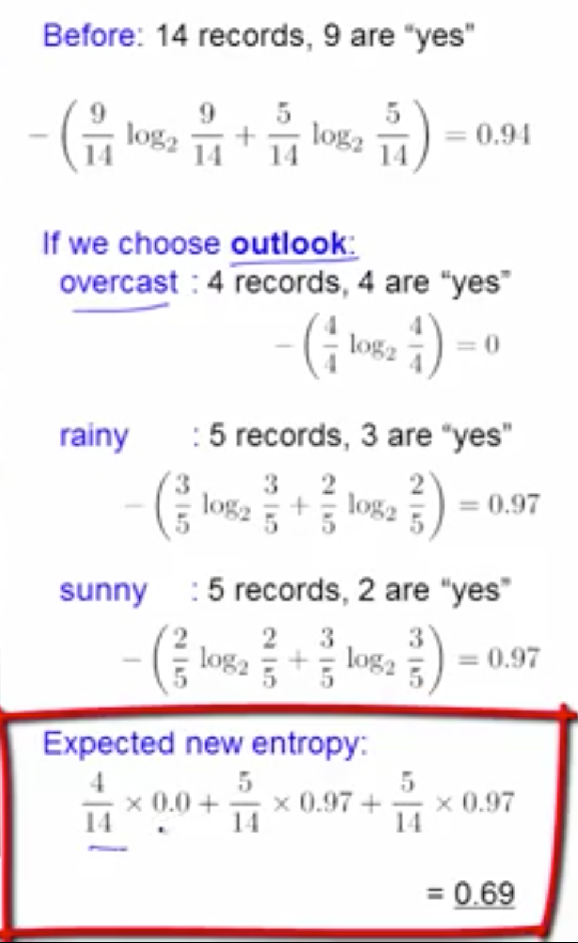

Slide 8
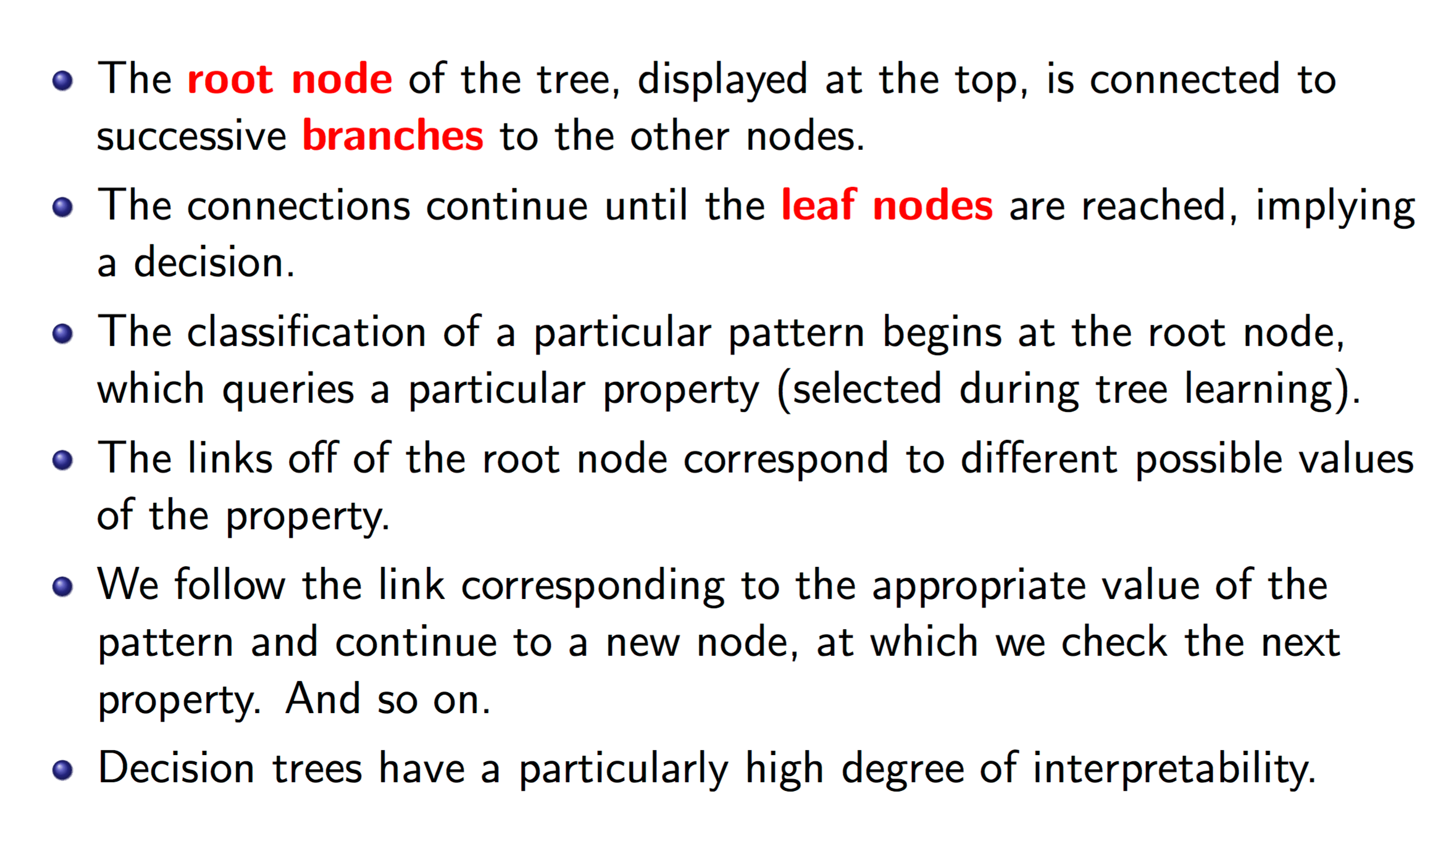
Insight to the Decision Tree

Slide 9
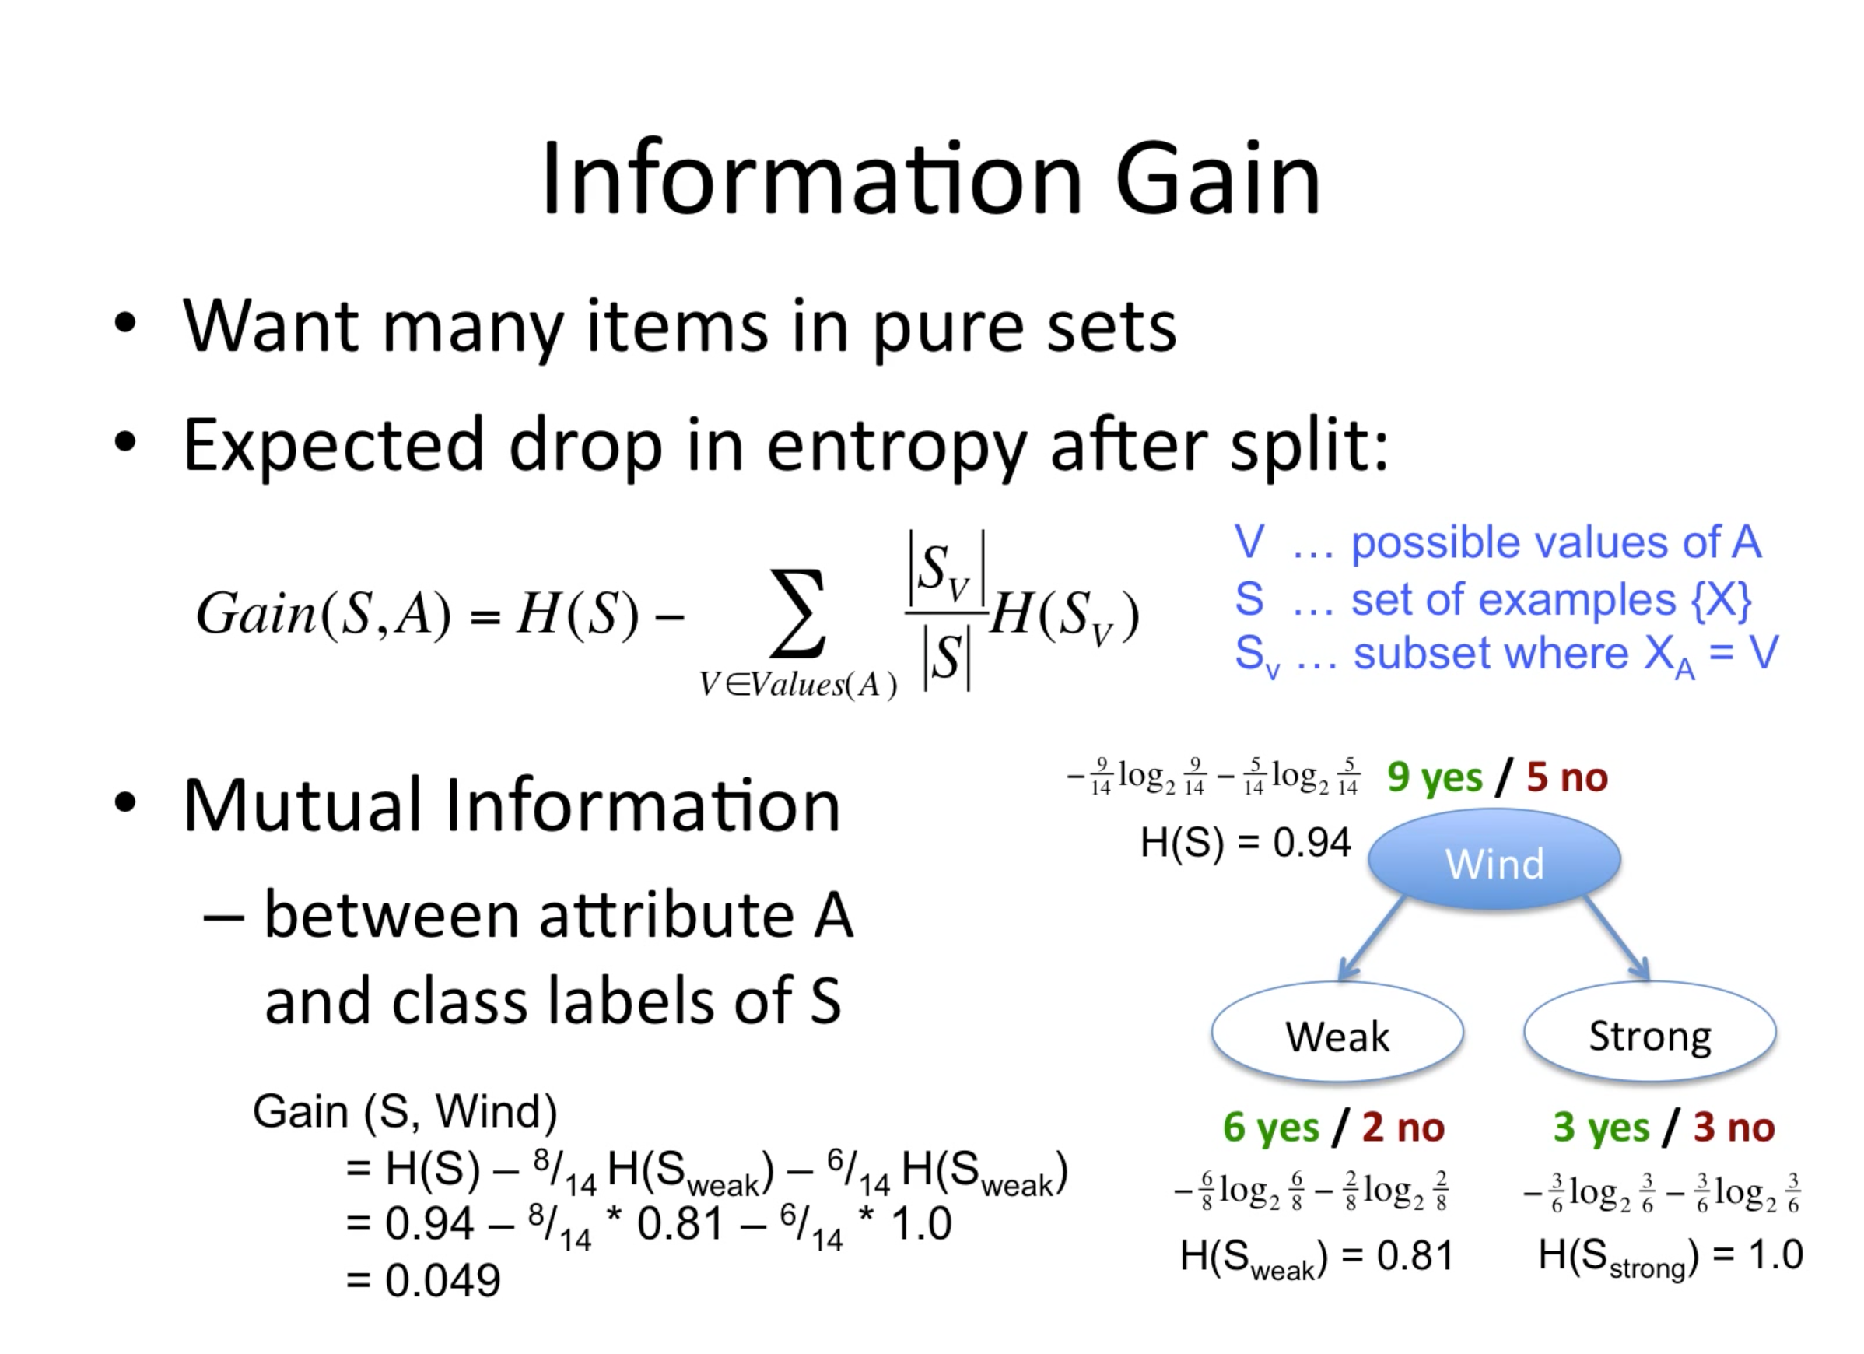
How to choose a criteria to split on : Information Gain

Slide 10
Understanding by implementing : Decision Tree- Classification
http://scikit-learn.org/stable/modules/tree.html#tree

Slide 11
Understanding by implementing : Decision Tree- Regression
http://scikit-learn.org/stable/auto_examples/tree/plot_tree_regression.html#sphx-glr-auto-examples-tree-plot-tree-regression-py

Slide 12
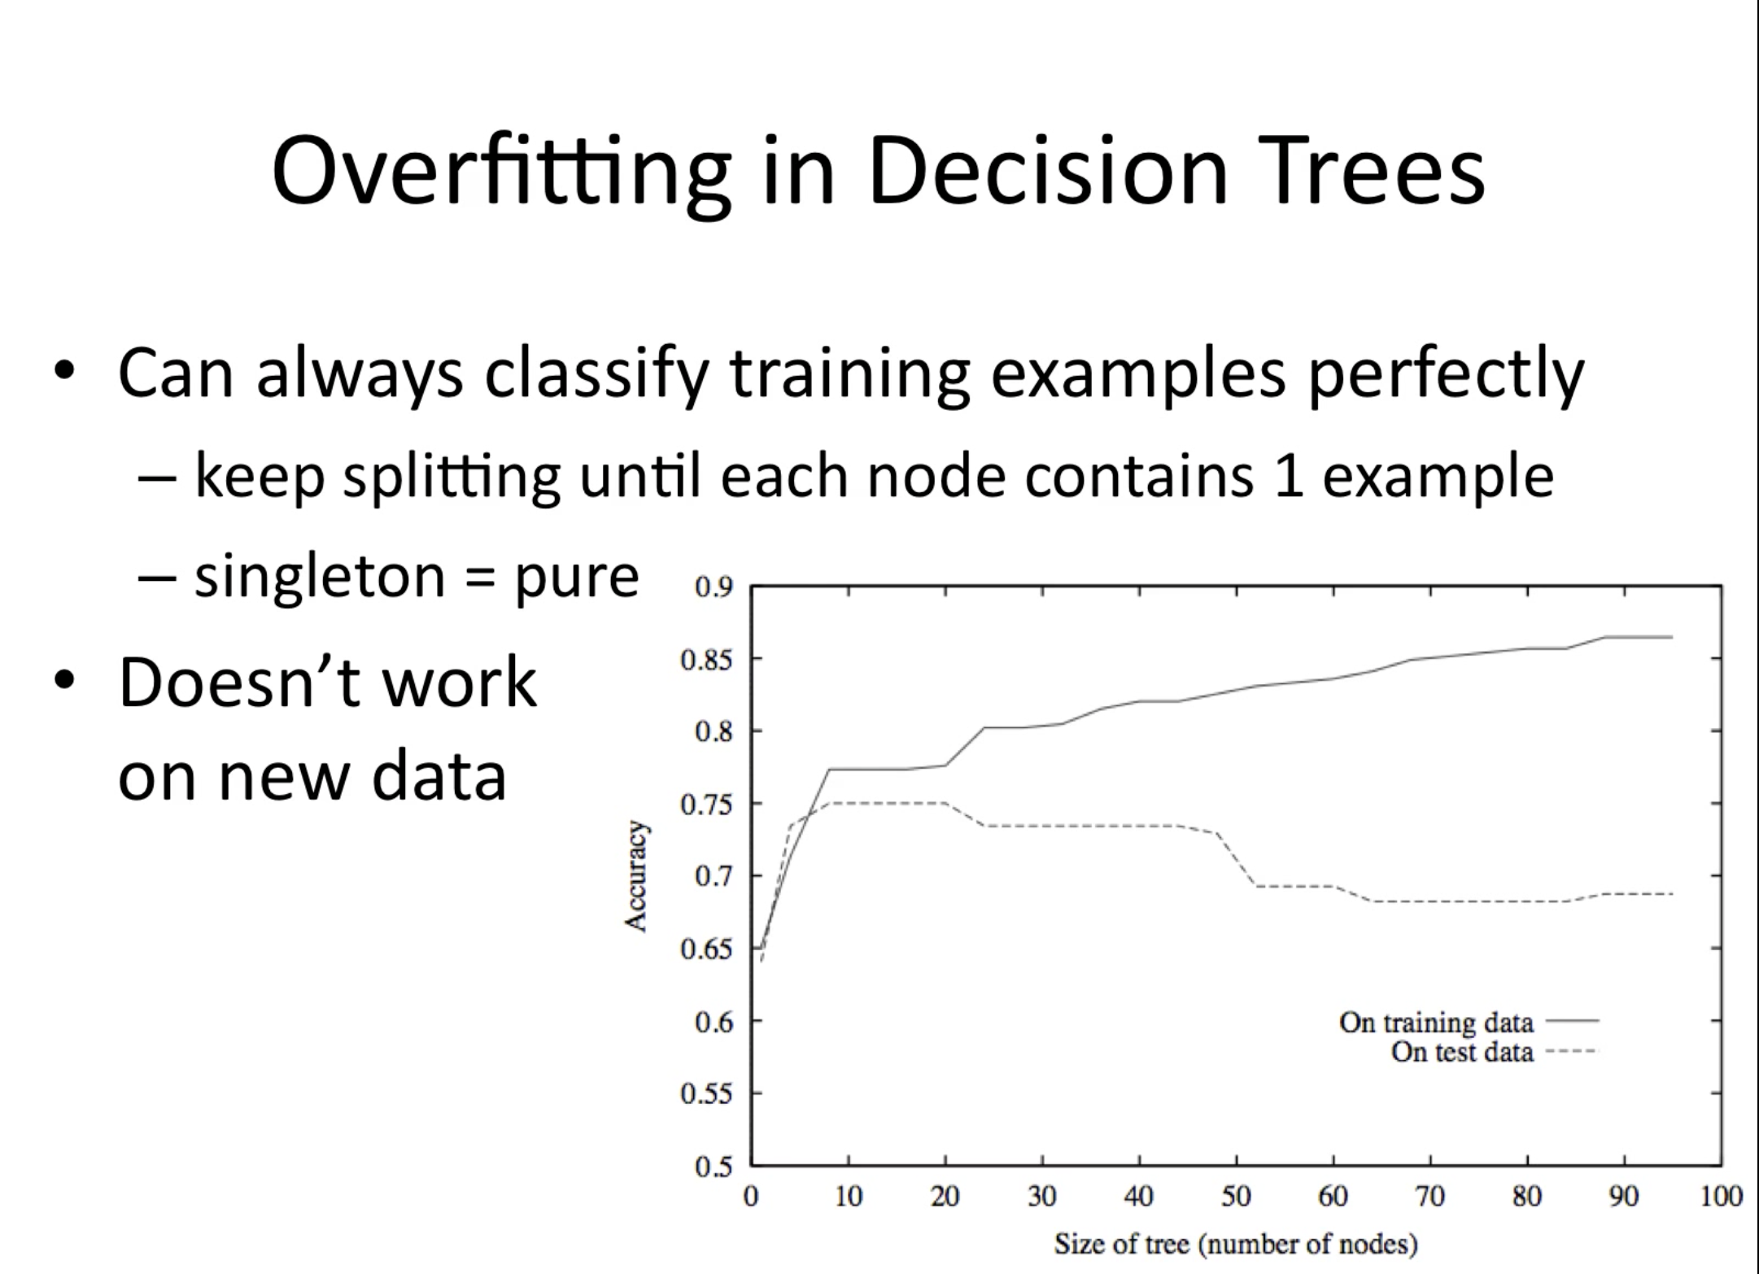
Overfitting

Slide 13
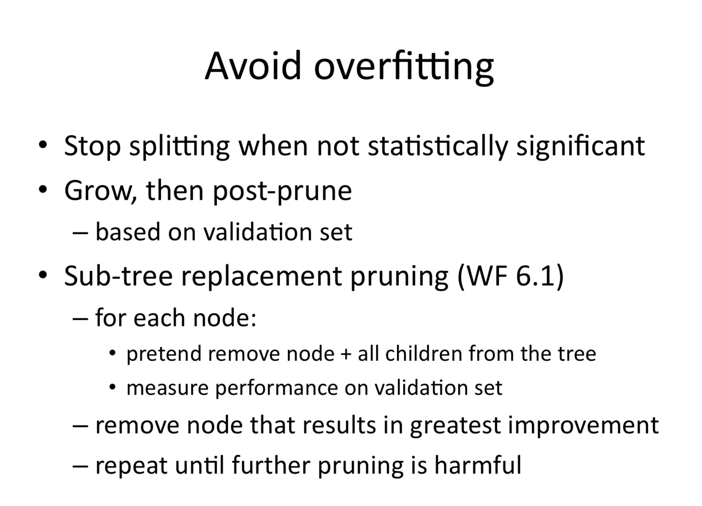
General Ideas for avoiding Overfitting

Slide 14
Advantages of using DT
Decision trees implicitly perform variable screening or feature selection
Decision trees require relatively little effort from users for data preparation
- for example if we have a dataset which measures revenue in millions and loan age in years, say; this will require some form of normalization or scaling before we can fit a regression model and interpret the coefficients. Such variable transformations are not required with decision trees because the tree structure will remain the same with or without the transformation.
Another feature which saves data prep time: missing values will not prevent splitting the data for building trees
Decision trees are also not sensitive to outliers since the splitting happens based on proportion of samples within the split ranges and not on absolute values.
Nonlinear relationships between parameters do not affect tree performance
The best feature of using trees for analytics - easy to interpret and explain to executives!

Slide 15
Disadvantages of using DT
Instability
The reliability of the information in the decision tree depends on feeding the precise internal and external information at the onset. Even a small change in input data can at times, cause large changes in the tree. Changing variables, excluding duplication information, or altering the sequence midway can lead to major changes and might possibly require redrawing the tree.
Complexity
Decision trees are easy to use compared to other decision-making models, but preparing decision trees, especially large ones with many branches, are complex and time-consuming affairs.
Too Much Information
One of the decision tree advantages are its listing comprehensive information and all possible solutions to an issue. Such comprehensiveness can, however, work both ways and need not always be an advantage. The most significant dangers with such excessive information is "paralysis of analysis" where the decision makers burdened with information overload takes time to process information, slowing down decision-making capacity

Slide 16
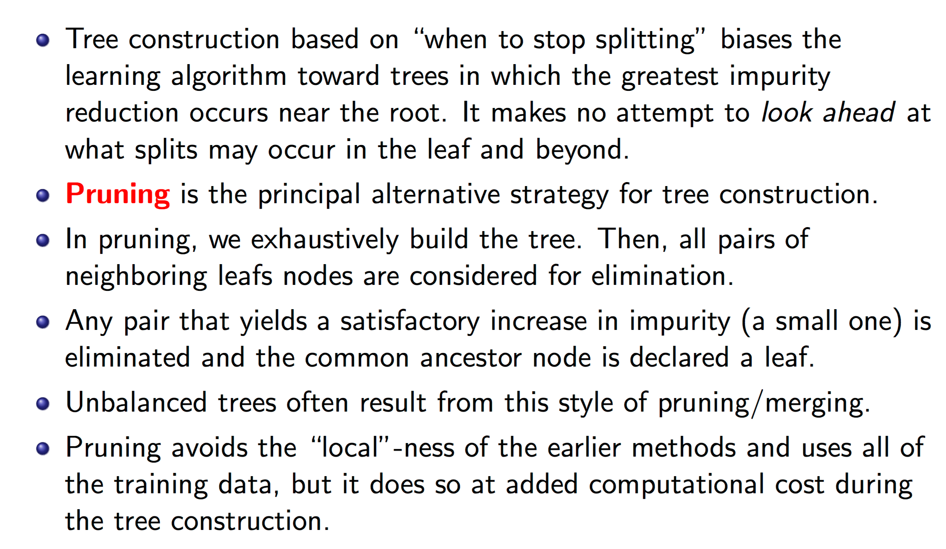
Tree Pruning

Slide 17
Ensemble Methods
When the underlying relationship between covariate and response is smooth, such a split point estimate will be affected by high variability. This problem is addressed by so called ensemble methods.
Here, multiple trees are grown on perturbed instances of the data set and their predictions are averaged. The simplest representative of such a procedure is called bagging.
Today we’re going to cover one of the most powerful ensemble methods called Random Forests

Slide 18
General Ensemble Techniques
http://machinelearningmastery.com/machine-learning-ensembles-with-r/

Slide 19
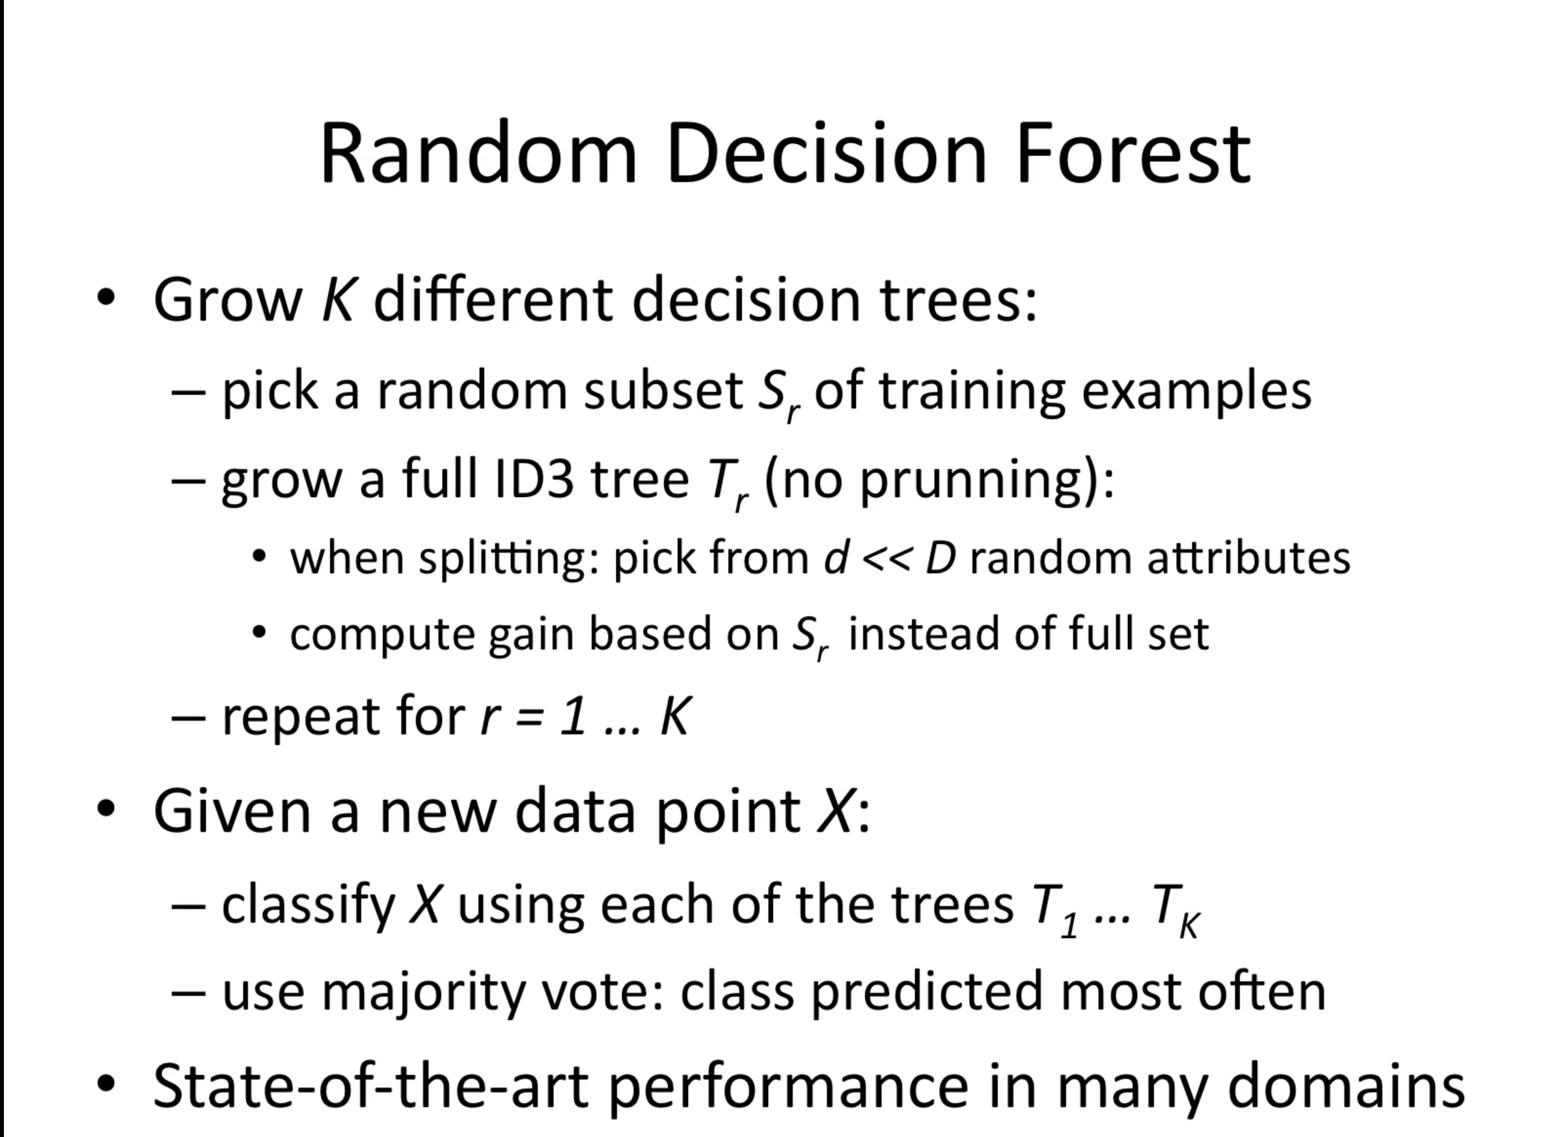
Random Forest Algorithm

Slide 20
Understanding by implementing : Random Forests
http://blog.yhat.com/posts/random-forests-in-python.html

Slide 21
Questions ?

Slide 22
THANK YOU ! :)

